Slide 1
Murach’s Modern JavaScript
Chapter 2
How to get started with JavaScript

Slide 2
Objectives
Applied
Code block comments and single-line comments.
Declare and initialize variables and constants of the number, string, and Boolean data types.
Code expressions that use arithmetic operators and methods from the Math and Number objects.
Use the console object to display data to a browser’s debugging console.
Combine strings of characters using the + operator, += operator, and template literals.
Use escape sequences to include special characters in strings.
Convert strings to numbers using parseInt(), parseFloat(), and Number().
Use dialogs to get input and display output.

Slide 3
Objectives (continued)
Knowledge
Describe how case-sensitivity, semicolons, and whitespace relate to the syntax for a JavaScript statement.
Describe these three primitive data types: numeric, string, and Boolean.
Describe what an object is and give an example of how one can be used.
Describe the syntax for referring to a method or property of an object.

Slide 4
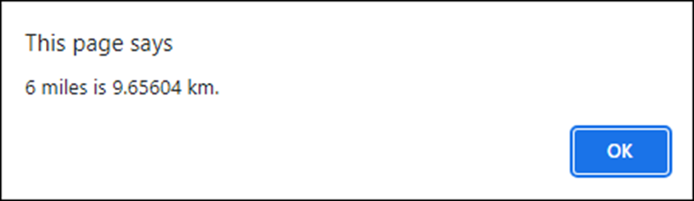
A script with a directive and three statements
<!DOCTYPE html>
<html>
<body>
<script>
"use strict";
let miles = 6;
let kilometers = miles * 1.60934;
alert(miles + " miles is " + kilometers + " km.");
</script>
</body>
</html>
The dialog displayed by these statements

Slide 5
Code that doesn’t work due to incorrect case
Alert("Hi"); // Alert is not the same as alert – // doesn't run
Use whitespace to make code easy to read
if (kilometers > 10) {
alert("Long");
} else {
alert("Short");
}
Without whitespace, code becomes hard to read
if(kilometers>10){alert("Long");}else{alert("Short");}

Slide 6
HTML that includes JavaScript with comments
<!DOCTYPE html>
<html>
<body>
<script>
/*
This code is designed to show how to use simple
JavaScript statements and comments. It was written
by Joel Murach in 2024.
*/
// enable strict mode
"use strict";
// set the number of miles
let miles = 6;
// calculate kilometers from miles
let kilometers = miles * 1.60934;

Slide 7
JavaScript with comments (continued)
// display the result of the calculation
alert(miles + " miles is " + kilometers + " km. ");
if (kilometers > 10) { // greater than 10
alert("Long");
} else { // 10 or less
alert("Short");
}
</script>
</body>
</html>

Slide 8
Guidelines for using comments
Use comments to describe portions of code that are hard to understand.
Don’t use comments unnecessarily.
If you update your code, update the comments at the same time.

Slide 9
Three primitive data types
Number
String
Boolean

Slide 10
Number values
15 // an integer
-21 // a negative integer
21.5 // a decimal value
-124.82 // a negative decimal value
1_000_000 // a number with separators for readability
-3.7e-9 // floating-point notation for -0.0000000037
Infinity // a number that's too large to be stored
-Infinity // a number that's too small to be stored
String values
"JavaScript" // a string with double quotes
'String Data' // a string with single quotes
"" // an empty string
Boolean values
True // equivalent to true, yes, or on
False // equivalent to false, no, or off

Slide 11
Declare and initialize a variable
let count = 1; // integer value of 1
let subtotal = 74.95; // decimal value of 74.95
let name = "Joseph"; // string value of "Joseph"
let postalCode = "95073"; // string value of "95073"
let email = ""; // empty string
let isValid = false; // Boolean value of false
let total = subtotal;
// assigns value of subtotal variable
let x = 0, y = 0;
// declares and initializes 2 variables
Reassign the value of a variable
let count = 1; // value of count is 1
count = 10; // value of count is now 10

Slide 12
Two primitive data types that indicate the absence of a value
undefined
null
An uninitialized variable
let message; // message is undefined – poor practice
Intentionally set a variable to no value
let message = null; // message is null – good practice

Slide 13
Declare and initialize a constant
const months = 12; // integer value of 12
const pi = 3.14; // decimal value of 3.14
const firstName = "Mary"; // string value of "Mary"
const postalCode = "95073"; // string value of "95073"
const message = ""; // empty string
const isValid = true; // Boolean value of true
const grandTotal = subtotal;
// assigns value of subtotal variable
const min = 0, max = 100;
// declares and initializes 2 constants

Slide 14
Code that fails when you assign a new value to a constant
const count = 1; // value of count is 1
count = 10; // TypeError: Assignment to constant variable.
Code that fails when you don’t initialize a constant
const count; // SyntaxError: Missing initializer
// in const declaration

Slide 15
Rules for naming variables and constants
Names can only contain letters, numbers, the underscore, and the dollar sign.
Names can’t start with a number.
Names are case-sensitive.
Names can be any length.
Names can’t be the same as reserved words.
Avoid using global properties and methods as names.
Valid names in JavaScript
Subtotal index_1 $
taxRate calculate_click $log

Slide 16
Recommendations for naming variables and constants
Use meaningful names. That way, your names aren’t likely to be reserved words or global properties or methods.
Be consistent. Either use camel case (taxRate) or snake case (tax_rate) to name variables and constants.
If you use snake case, use lowercase for all letters.
Always start variable and constant names with a lowercase letter.
Camel case versus snake case
taxRate tax_rate
calculateClick calculate_click
emailAddress email_address
futureValue future_value

Slide 17
Reserved words in JavaScript
Abstract else instanceof switch
Arguments enum int synchronized
Boolean eval interface this
Break export let throw
Byte extends long throws
Case false native transient
Catch final new true
Char finally null try
Class float package typeof
Const for private var
Continue function protected void
Debugger goto public volatile
Default if return while
Delete implements short with
Do import static yield
Double in super

Slide 18
JavaScript’s arithmetic operators
Operator | Name
+ | Addition
- | Subtraction
* | Multiplication
/ | Division
% | Modulus
** | Exponentiation
++ | Increment
-- | Decrement

Slide 19
Expressions that perform simple arithmetic operations
5 + 7 // 12
5 – 12 // -7
6 * 7 // 42
13 / 4 // 3.25
13 % 4 // 1
2 ** 3 // 8
Arithmetic expressions
An arithmetic expression consists of one or more operands that are operated upon by arithmetic operators.

Slide 20
Statements that increment and decrement a variable
let counter = 0; // counter = 0
counter++; // counter = 1
counter--; // counter = 0

Slide 21
The order of precedence for arithmetic operations
Order | Operators | Direction
1 | ++ | Left to right
2 | -- | Left to right
3 | * / % | Left to right
4 | + - | Left to right
Expressions that use the order of precedence
3 + 4 * 5 // 23 (the multiplication is done first)
(3 + 4) * 5 // 35 (the addition is done first)
13 % 4 + 9 // 10 (the modulus is done first)
13 % (4 + 9) // 0 (the addition is done first)
Order of precedence
An arithmetic expression is evaluated based on the order of precedence of the operators. To override the order of precedence, you can use parentheses.

Slide 22
Statements that calculate sales tax
const subtotal = 200;
const taxPercent = .05;
const taxAmount = subtotal * taxPercent; // 10
const total = subtotal + taxAmount; // 210

Slide 23
Statements that calculate the perimeter of a rectangle
const width = 4.25;
const length = 8.5;
const perimeter = (2 * width) + (2 * length)
// (8.5 + 17) = 25.5

Slide 24
The most useful compound assignment operators
+=
-=
*=
Statements that use the compound assignment operators
let subtotal = 74.95;
subtotal += 20.00; // subtotal = 94.95
let counter = 10;
counter -= 1; // counter = 9
let price = 100;
price *= .8; // price = 80

Slide 25
Three ways to increment a variable by 1
let counter = 1; // counter = 1
counter = counter + 1; // counter = 2
counter += 1; // counter = 3
counter++; // counter = 4

Slide 26
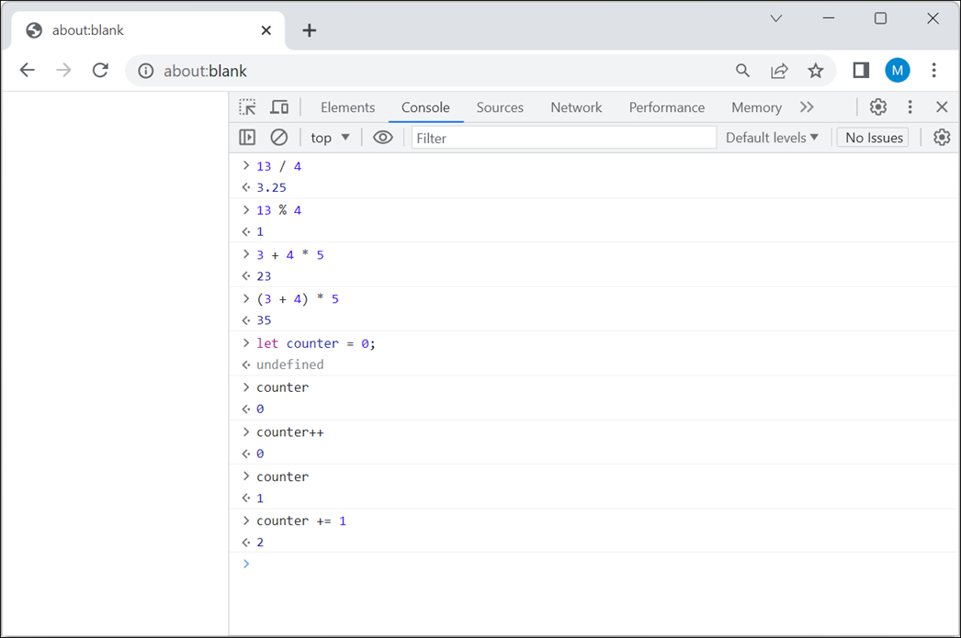
Chrome’s browser console with expressions and statements

Slide 27
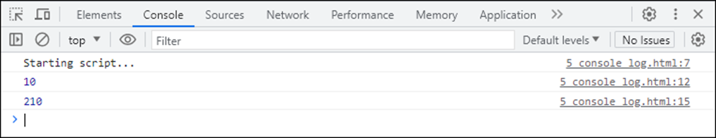
A method of the console object that displays data
log(data)
Display some data in the console
console.log("Starting script...")
const subtotal = 200;
const taxPercent = .05;
const taxAmount = subtotal * taxPercent;
console.log(taxAmount);
const total = subtotal + taxAmount;
console.log(total);
The data displayed in the console

Slide 28
Basic object concepts
JavaScript provides built-in objects, like the console object that you can use to communicate with the console.
An object can contain one or more methods.
A method performs an action that’s related to the object.
To execute a method, you call it from an object.
To call a method of an object, you typically code the name of the object, the dot operator (.), the name of the method, and a set of parentheses.
Within the parentheses of a method call, you can code zero or more parameters, separated by commas, that specify the data to pass to the method.

Slide 29
The syntax of the typeof operator
typeof operand
Check the type of a value
const productName = "Hammer";
const price = 11.99;
const inStock = true;
console.log(typeof productName); // string
console.log(typeof price); // number
console.log(typeof inStock); // boolean

Slide 30
A method of the Number object that converts a number to a string
toFixed(n)
A function that converts data to a number
Number(data)
How to use this method and function
const num1 = 6.250001; // num1 = 6.250001
const numStr = num1.toFixed(2); // numStr = "6.25"
const num2 = Number(numStr); // num2 = 6.25
Function concepts
A function performs an action much like a method. However, a function isn’t related to an object.
The Number() function is a built-in function that’s provided by JavaScript.

Slide 31
An arithmetic result that isn’t precise
const subtotal = 74.95;
const salesTax = subtotal * .1;
// salesTax = 7.495000000000001
const total = subtotal + salesTax;
// total = 82.44500000000001

Slide 32
A result that’s rounded to be precise
const subtotal = 74.95;
let salesTax = subtotal * .1;
// salesTax = 7.495000000000001
salesTax = salesTax.toFixed(2); // salesTax = "7.50"
salesTax = Number(salesTax); // salesTax = 7.5
const total = subtotal + salesTax; // total = 82.45
A more concise way to code the previous example
const subtotal = 74.95;
let salesTax = subtotal * .1;
// salesTax = 7.495000000000001
salesTax = Number(salesTax.toFixed(2)); // salesTax = 7.5
const total = subtotal + salesTax; // total = 82.45

Slide 33
A property of the Math object
PI
Properties
A property stores data that’s related to an object. To access the value of a property, you typically code the name of the object, followed by the dot operator and the name of the property.

Slide 34
Some methods of the Math object
round(x)
ceil(x)
floor(x)
trunc(x)
pow(x, power)
sqrt(x)
min(x1, x2, ...)
max(x1, x2, ...)
random()

Slide 35
Round decimal values to integers
Math.round(12.5) // 13
Math.round(-3.4) // -3
Math.round(-3.5) // -3
Math.round(-3.51) // -4
Math.floor(12.5) // 12
Math.ceil(12.5) // 13
Math.trunc(12.5) // 12
Math.floor(-3.4) // -4
Math.ceil(-3.4) // -3
Round numbers to 2 and 3 decimal places
const dec2 = Math.round(3.14159 * 100) / 100;
// dec2 is 3.14
const dec3 = Math.round(3.14159 * 1000) / 1000;
// dec3 is 3.142

Slide 36
Work with powers and square roots
Math.pow(2, 3) // 8 (same as 2 ** 3)
Math.sqrt(16) // 4
Get the minimum and maximum values
Math.max(12.5, -3.4) // 12.5
Math.min(12.5, -3.4) // -3.4
Calculate the area of a circle that has a radius of 3
const area = Math.PI * Math.pow(3, 2);
// area is 28.274333882308138
Generate a random number between n 1 and 10
const randNum = Math.random() * 10;
// get a random num between 0 and 10
const randInt = Math.ceil(randNum);
// round up to nearest integer

Slide 37
The concatenation operators for strings
+
+=

Slide 38
Examples that join strings
Constants for the next three examples
const firstName = "Grace";
const lastName = "Hopper";
Use the + operator
const name = lastName + ", " + firstName;
// name is "Hopper, Grace"
Use the += operator
let name = lastName; // name is "Hopper"
name += ", "; // name is "Hopper, "
name += firstName; // name is "Hopper, Grace"
Use a template literal
const name = `${lastName}, ${firstName}`;
// name is "Hopper, Grace"

Slide 39
More examples that join strings
Constants for the next two examples
const greeting = "Hello"; // string data type
const price = 15.99; // number data type
const isValid = true; // Boolean data type
Use the + operator with an expression that spans multiple lines
const message = greeting + "! Is the price really just "
+ price + "?" + "Answer: " + isValid + ".";
// message is "Hello! Is the price really just 15.99? Answer: true."
Use a template literal that spans multiple lines
const message = `${greeting}! Is the price really just ${price}?
Answer: ${isValid}.`;
// message is "Hello! Is the price really just 15.99?
Answer: true."

Slide 40
Escape sequences that can be used in strings
Operator | Description
\' | Single quotation mark in a single quoted string
\" | Double quotation mark in a double quoted string
\n | New line character
\\ | Backslash

Slide 41
Examples that use escape sequences
Four ways to include quotation marks in a string
"Type \"x\" to exit" // Type "x" to exit
'Type \'x\' to exit' // Type 'x' to exit
'Type "x" to exit' // Type "x" to exit
"Type 'x' to exit" // Type 'x' to exit
A new line character in a string
"Title: Modern JavaScript\nPrice: 59.50"
// Title: Modern JavaScript
// Price: 59.50
Two backslashes in a string
"C:\\murach\\javascript" // C:\murach\javascript

Slide 42
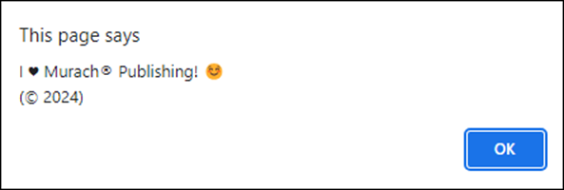
Some of the codes for Unicode characters
Code | Character
\u00A9 | ©
\u00AE | ®
\u263A | ☺
\u2665 | ♥
Unicode characters in a string
alert("I \u2665 Murach\u00AE Publishing! \u263A \n(\u00A9 2024)");

Slide 43
Two methods of the window object
alert(str)
prompt(str, default)
Two ways to call a method of the window object
window.alert("Hello!");
alert("Hello!");
The window object
The window object is the global object for JavaScript in a browser, which means it’s the default object.
Because the window object is the default object, you can omit the object name and dot operator when calling methods from it.

Slide 44
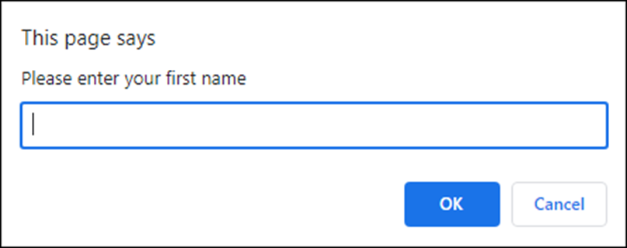
Get input from a user
const firstName = prompt("Please enter your first name");
The dialog that’s displayed

Slide 45
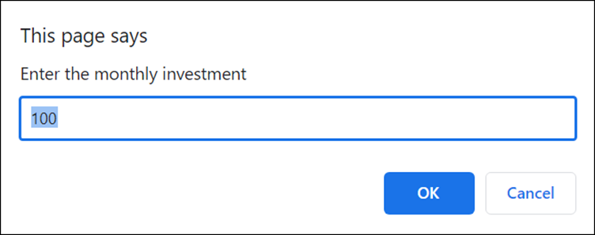
Get input from a user and supply a default value
const monthlyInvestment =
prompt("Enter the monthly investment", 100);
The dialog that’s displayed

Slide 46
Two functions for parsing numbers
parseInt(str)
parseFloat(str)
A special value these functions can return
NaN

Slide 47
Convert strings to numbers
const num1 = parseInt("12345.6789"); // 12345
const num2 = parseFloat("12345.6789"); // 12345.6789
const num3 = parseInt("Hello"); // NaN
Convert user input to numbers
let months = prompt("Enter number of months", 12);
months = parseInt(months);
let monthlySales = prompt("Enter monthly sales average");
monthlySales = parseFloat(monthlySales);
A more concise way to code these examples
const months =
parseInt(prompt("Enter number of months", 12));
const monthlySales =
parseFloat(prompt("Enter monthly sales average"));

Slide 48
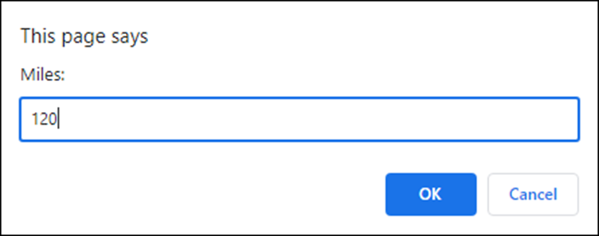
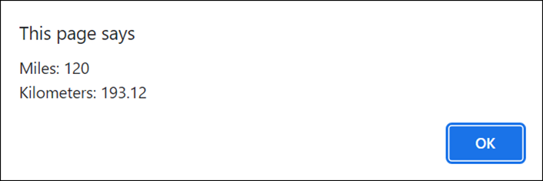
Two dialogs for the Miles to Kilometers app
The first dialog
The second dialog

Slide 49
The HTML for the Miles to Kilometers app
<!DOCTYPE html>
<html>
<head>
<title>Miles to Kilometers</title>
</head>
<body>
<script src="miles_to_kms.js"></script>
</body>
</html>

Slide 50
The JavaScript for the Miles to Kilometers app
"use strict";
// get miles from user
const miles = parseFloat(prompt("Miles:"));
// calculate kilometers
const kilometers = miles * 1.60934;
// display results
const results = "Miles: " + miles + "\n" +
"Kilometers: " + kilometers.toFixed(2);
alert(results);

Slide 51
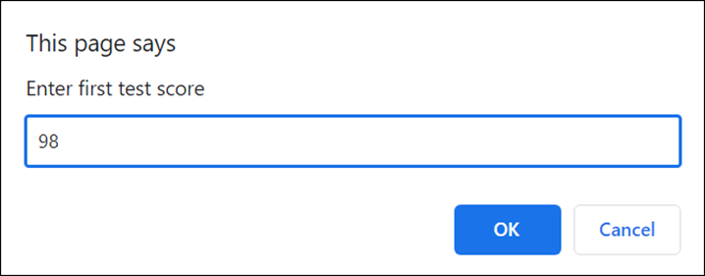
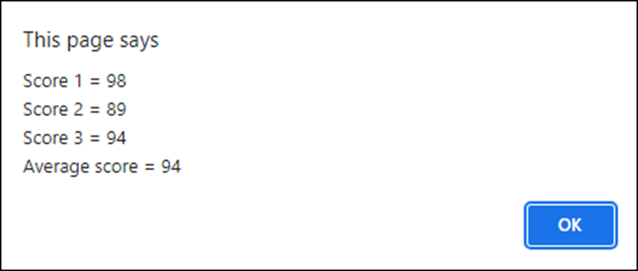
Two dialogs for the Test Scores app
The first dialog
The last dialog

Slide 52
The JavaScript for the Test Scores app (part 1)
"use strict";
// initialize total variable
let total = 0;
// get 3 scores from user and add them together
const score1 =
parseInt(prompt("Enter first test score"));
total += score1;
const score2 =
parseInt(prompt("Enter second test score"));
total += score2;
const score3 =
parseInt(prompt("Enter third test score"));
total += score3;
// calculate the average
const average = Math.round(total/3);

Slide 53
The JavaScript for the Test Scores app (part 2)
// display the scores
const result = "Score 1 = " + score1 + "\n" +
"Score 2 = " + score2 + "\n" +
"Score 3 = " + score3 + "\n" +
"Average score = " + average;
alert(result);

